Slide 1

Stats 1
Descriptive Statistics

Slide 2
Mean, Mode, Median
These are the basic descriptive statistics.
You will all know them, although maybe not remember exactly mode and median.

Slide 3
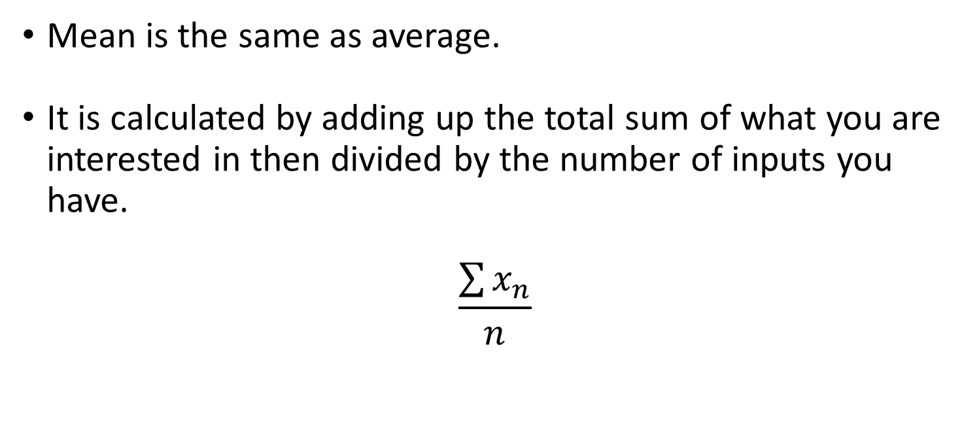
Mean
Mean is the same as average.
It is calculated by adding up the total sum of what you are interested in then divided by the number of inputs you have.
$$\frac{\sum{x_{n}}}{n}$$

Slide 4
Mode
Mode is just the most common number in the series.
1,2,2,3,4,3,2,2,5,2,2,3,1,5

Slide 5
Mode
Mode is just the most common number in the series.
1,2,2,3,4,3,2,2,5,2,2,3,1,5
What is the Mode?

Slide 6
Mode
Mode is just the most common number in the series.
1,2,2,3,4,3,2,2,5,2,2,3,1,5
What is the Mode?
2

Slide 7
Median
The median is the number that is half way in the sequence.
First put the sequence into numerical order.
Count the number of values in it, the value at half of that.

Slide 8
Median
The median is the number that is half way in the sequence.
First put the sequence into numerical order.
Count the number of values in it, the value at half of that.
1 2 3 4 5 6 7 8 9 10

Slide 9
Median
Ten numbers in the sequence.
Half of 10 is 5, 5 is our median.
1 2 3 4 5 6 7 8 9 10

Slide 10
Median
Nine numbers in the sequence.
Half of 9 is 4.5, 4.5 is not in our sequence but it is still our median.
1 2 3 4 5 6 7 8 9

Slide 11
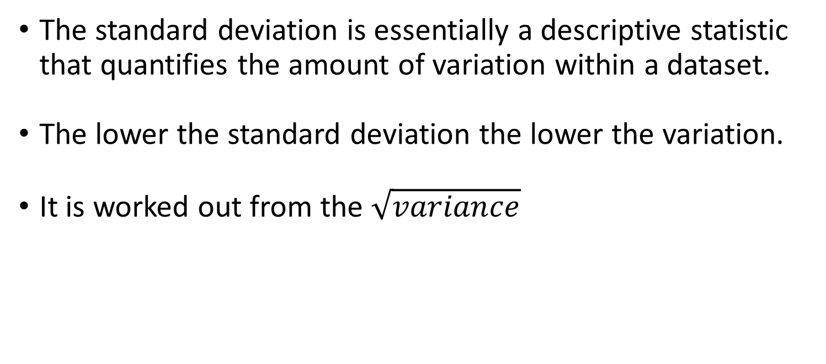
Standard Deviation
The standard deviation is essentially a descriptive statistic that quantifies the amount of variation within a dataset.
The lower the standard deviation the lower the variation.
It is worked out from the $\sqrt{variance}$

Slide 12
Standard Deviation
The standard deviation is essentially a descriptive statistic that quantifies the amount of variation within a dataset.
The lower the standard deviation the lower the variation.
It is worked out from the $\sqrt{variance}$

Slide 13

Standard Deviation
It is worked out from the $\sqrt{variance}$
Variance is essentially each point of data minus the mean divided by the number of datapoints.

Slide 14
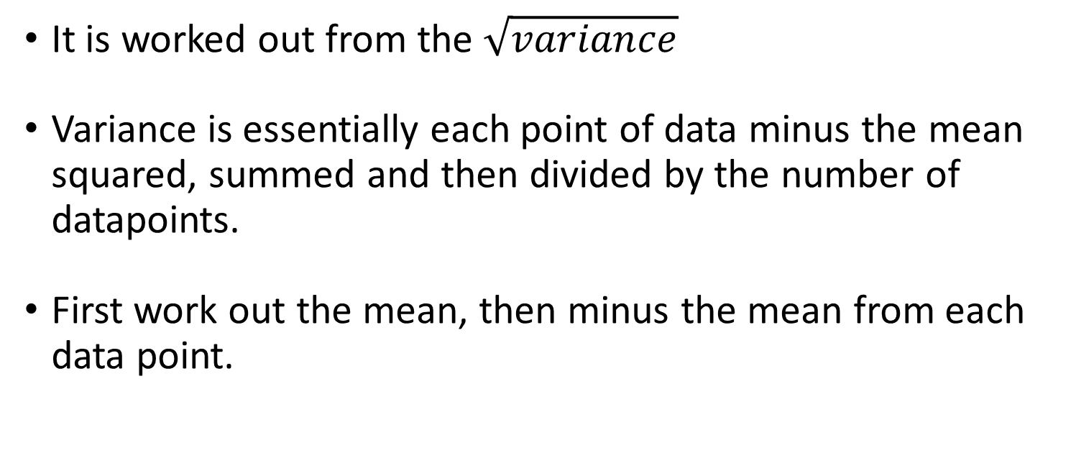
Standard Deviation
It is worked out from the $\sqrt{variance}$
Variance is essentially each point of data minus the mean squared, summed and then divided by the number of datapoints.
First work out the mean, then minus the mean from each data point.

Slide 15
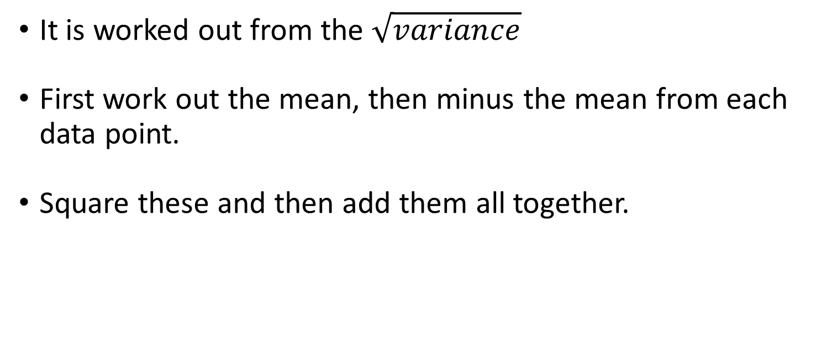
Standard Deviation
It is worked out from the $\sqrt{variance}$
First work out the mean, then minus the mean from each data point.
Square these and then add them all together.

Slide 16
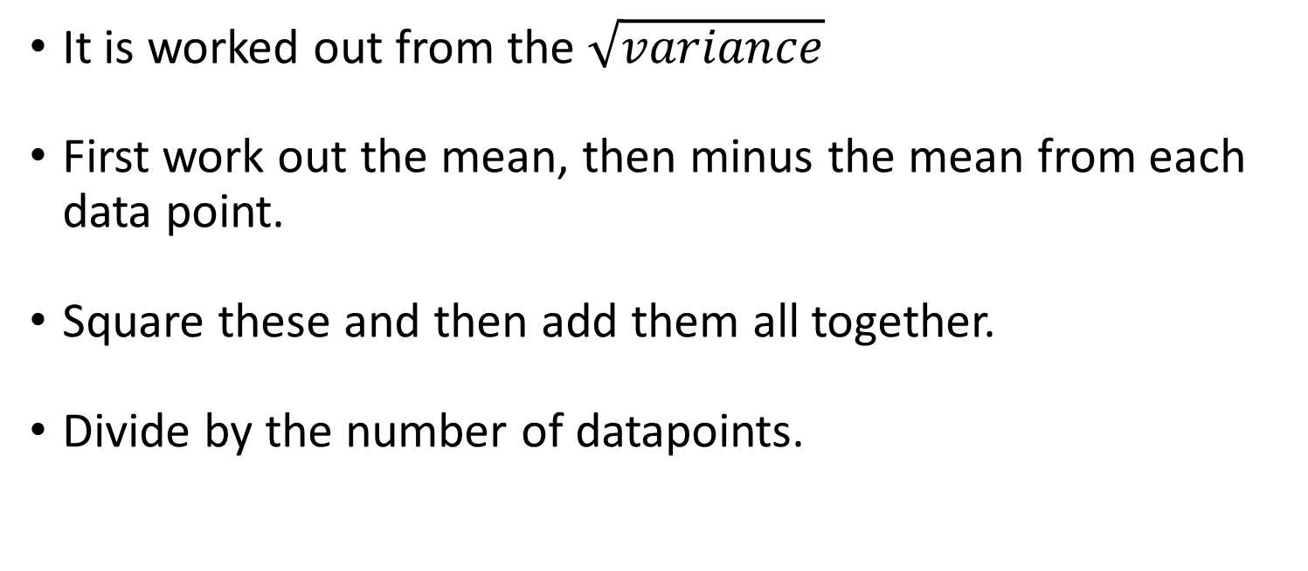
Standard Deviation
It is worked out from the $\sqrt{variance}$
First work out the mean, then minus the mean from each data point.
Square these and then add them all together.
Divide by the number of datapoints.

Slide 17
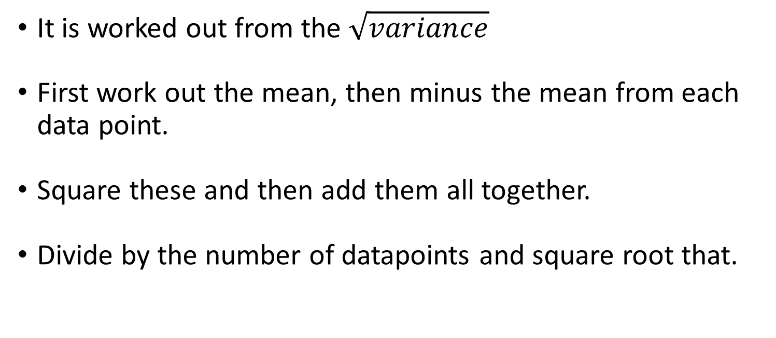
Standard Deviation
It is worked out from the $\sqrt{variance}$
First work out the mean, then minus the mean from each data point.
Square these and then add them all together.
Divide by the number of datapoints and square root that.

Slide 18

Standard Deviation
It is worked out from the $\sqrt{variance}$
600,470,170,430,300

Slide 19

Standard Deviation
It is worked out from the $\sqrt{variance}$
Work out the mean
600,470,170,430,300

Slide 20

Standard Deviation
It is worked out from the $\sqrt{variance}$
Work out the mean
600,470,170,430,300 = 1970/5 = 394

Slide 21
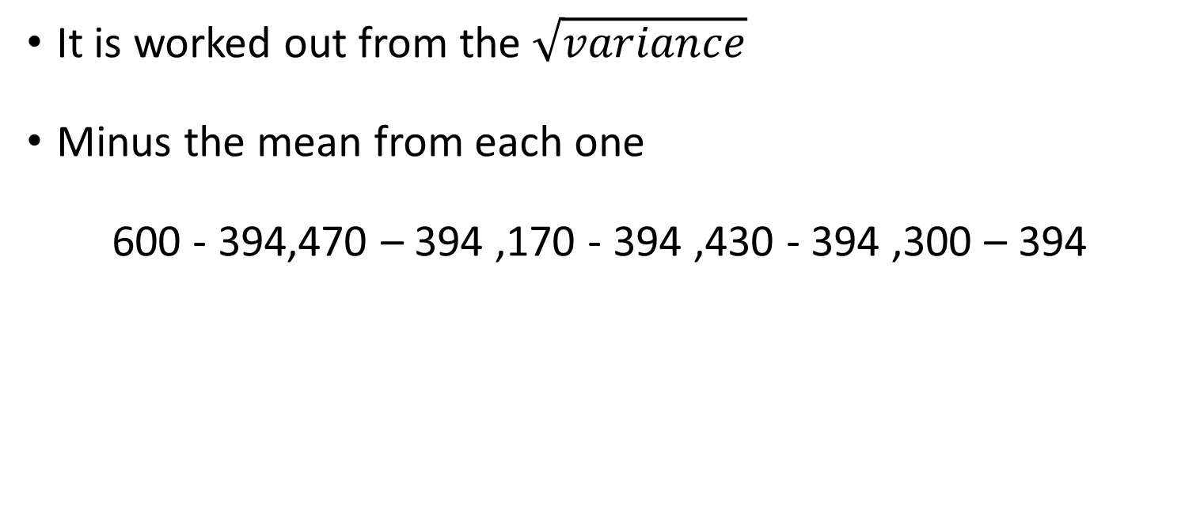
Standard Deviation
It is worked out from the $\sqrt{variance}$
Minus the mean from each one
600 - 394,470 – 394 ,170 - 394 ,430 - 394 ,300 – 394

Slide 22

Standard Deviation
It is worked out from the $\sqrt{variance}$
Minus the mean from each one
206, 76, -224,36,-94

Slide 23

Standard Deviation
It is worked out from the $\sqrt{variance}$
Square them
206², 76², -224², 36², -94²

Slide 24

Standard Deviation
It is worked out from the $\sqrt{variance}$
Square them and sum them
206² + 76² + -224² + 36² + -94²

Slide 25
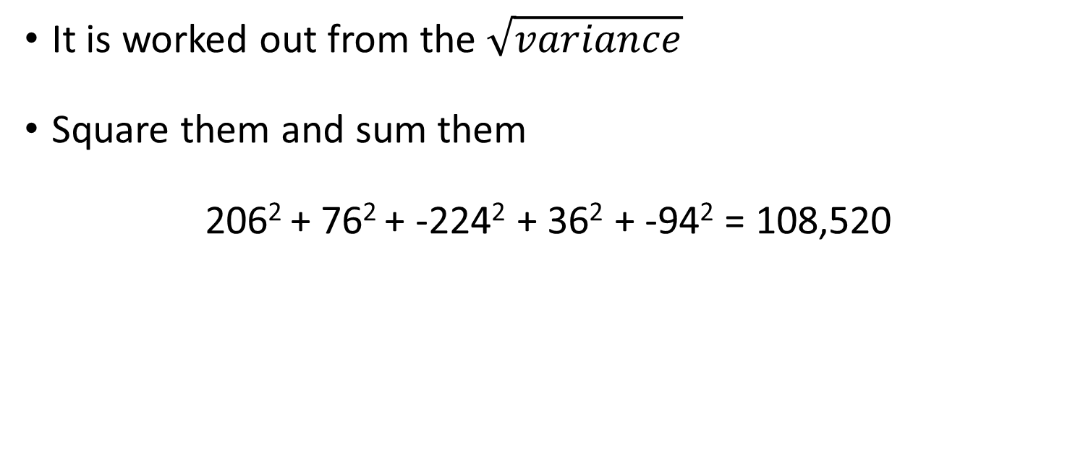
Standard Deviation
It is worked out from the $\sqrt{variance}$
Square them and sum them
206² + 76² + -224² + 36² + -94² = 108,520

Slide 26
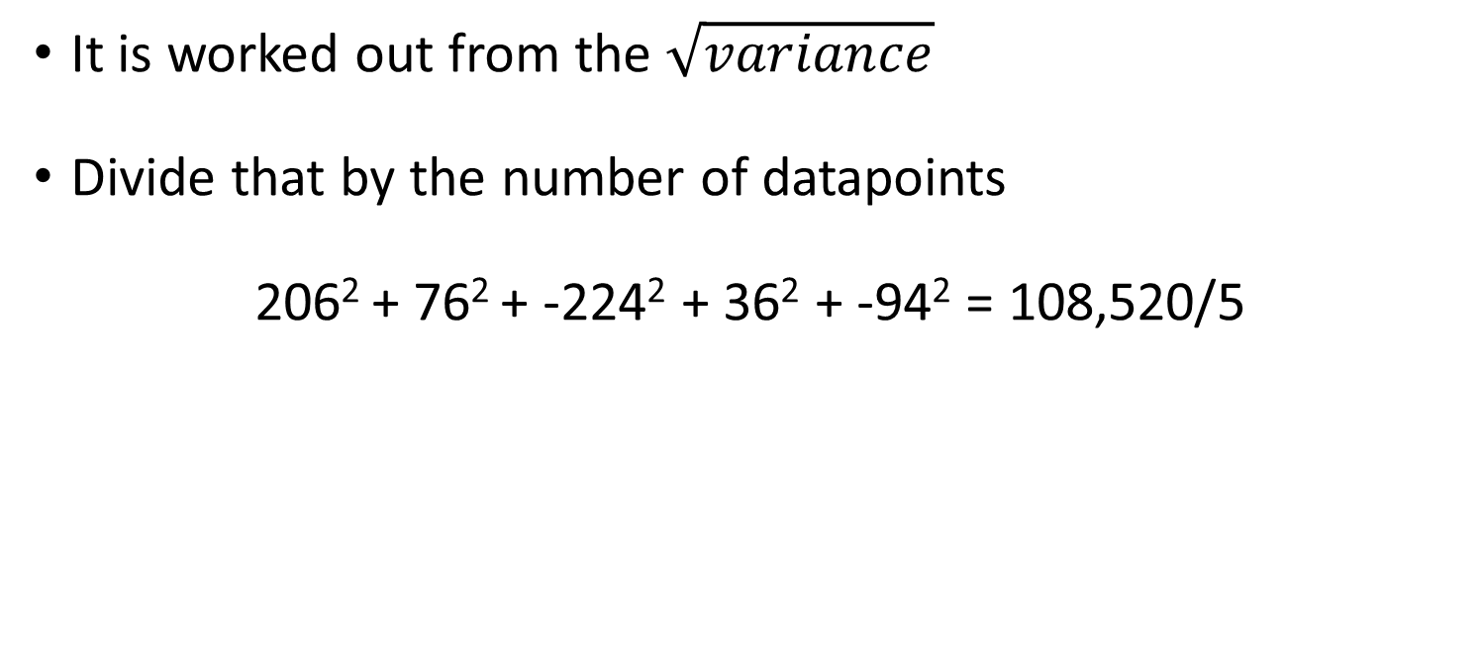
Standard Deviation
It is worked out from the $\sqrt{variance}$
Divide that by the number of datapoints
206² + 76² + -224² + 36² + -94² = 108,520/5

Slide 27
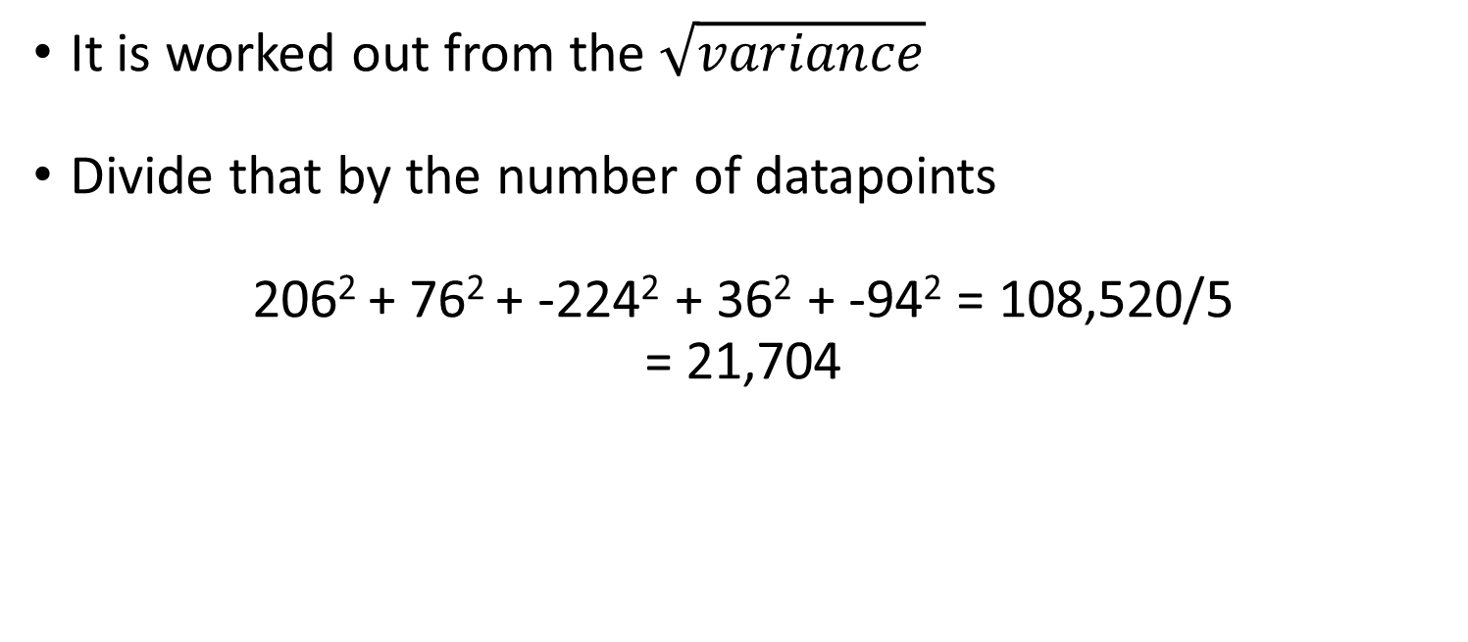
Standard Deviation
It is worked out from the $\sqrt{variance}$
Divide that by the number of datapoints
206² + 76² + -224² + 36² + -94² = 108,520/5
= 21,704

Slide 28
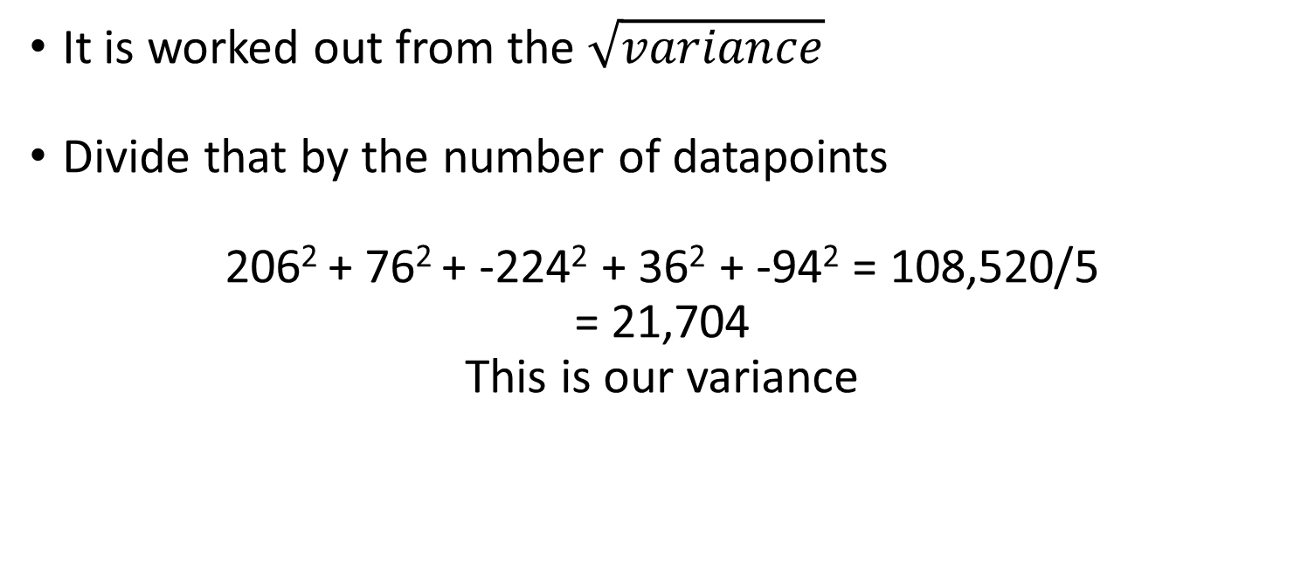
Standard Deviation
It is worked out from the $\sqrt{variance}$
Divide that by the number of datapoints
206² + 76² + -224² + 36² + -94² = 108,520/5
= 21,704
This is our variance

Slide 29

Standard Deviation
It is worked out from the $\sqrt{variance}$
We have our variance
21,704

Slide 30

Standard Deviation
It is worked out from the $\sqrt{variance}$
We want SD
√21704

Slide 31

Standard Deviation
It is worked out from the $\sqrt{variance}$
We want SD
√21704
SD = 147.32

Slide 32
Confidence Intervals
Confidence intervals are in essence a range of values that are used to describe the range which you believe a certain proportion of all your data will fall into.
Normally 95% CI which is the range that will cover 95% of the data.
This is used for determining significance.

Slide 33
Confidence Intervals
Confidence intervals are in essence a range of values that are used to describe the range which you believe a certain proportion of all your data will fall into.
Normally 95% CI which is the range that will cover 95% of the data.
This is used for determining significance.

Slide 34
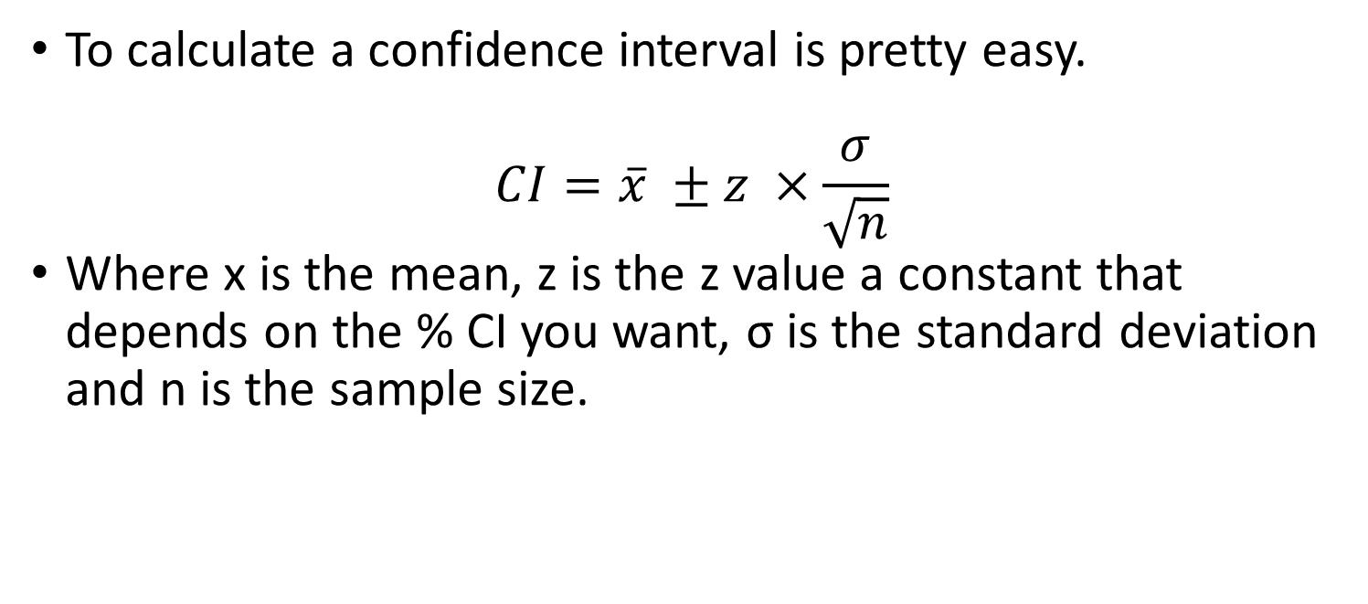
Confidence Intervals
To calculate a confidence interval is pretty easy.
$$CI=\overline{x} ±z ×\frac{σ}{\sqrt{n}}$$
Where x is the mean, z is the z value a constant that depends on the % CI you want, σ is the standard deviation and n is the sample size.

Slide 35
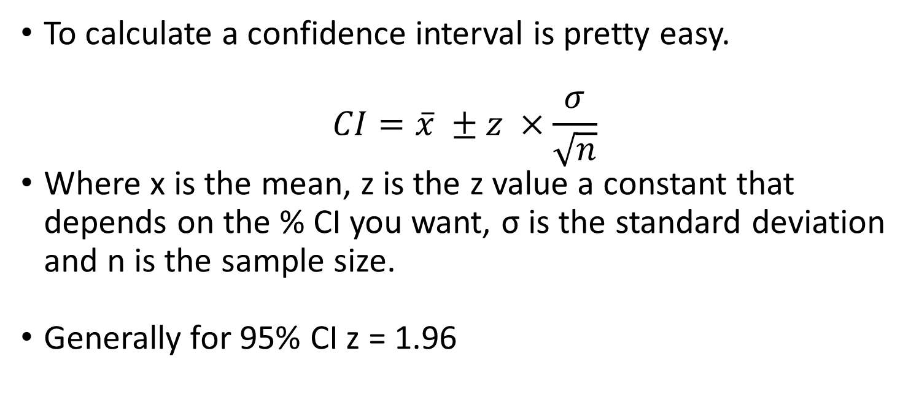
Confidence Intervals
To calculate a confidence interval is pretty easy.
$$CI=\overline{x} ±z ×\frac{σ}{\sqrt{n}}$$
Where x is the mean, z is the z value a constant that depends on the % CI you want, σ is the standard deviation and n is the sample size.
Generally for 95% CI z = 1.96

Slide 36
T - Tests
T–Tests are the simplest form of statistical test, they compare the means of a sample to the means of another sample or 0.
They then tell you if there is a significant difference there.

Slide 37
T - Tests
T–Tests are the simplest form of statistical test, they compare the means of a sample to the means of another sample or 0.
They then tell you if there is a significant difference there.
There are paired and unpaired (1 or 2 tailed) t tests depending on if you are comparing one thing to 0 or two things to each other.

Slide 38
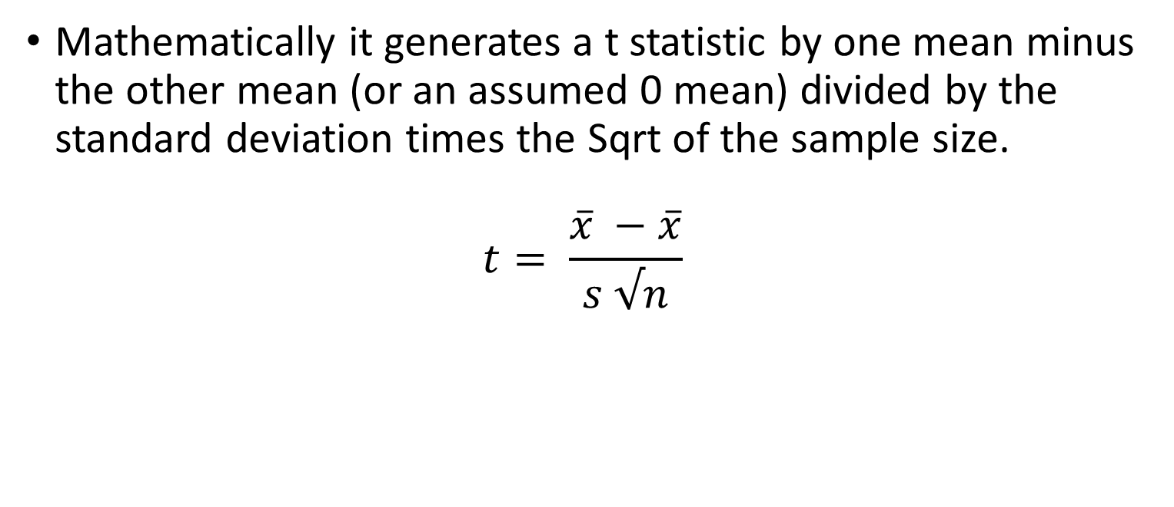
T - Tests
Mathematically it generates a t statistic by one mean minus the other mean (or an assumed 0 mean) divided by the standard deviation times the Sqrt of the sample size.
$$t= \frac{\overline{x} −\overline{x}}{s √n}$$

Slide 39

T - Tests
$$t= \frac{\overline{x} −\overline{x}}{s √n}$$
It then literally looks up this t value in a table to see if it is large enough to be significant.

